Slide 1

DSC JIIT, Noida
Welcome to Google Cloud Program!

Slide 2
Raise your hands if ...

Slide 3
Cloud Computing
In cloud computing, the capital investment in building and maintaining data centers is replaced by consuming IT resources as an elastic, utility-like service from a cloud “provider” (including storage, computing, networking, data processing and analytics, application development, machine learning, and even fully managed services).
Notes:
Boring Definition

Slide 4
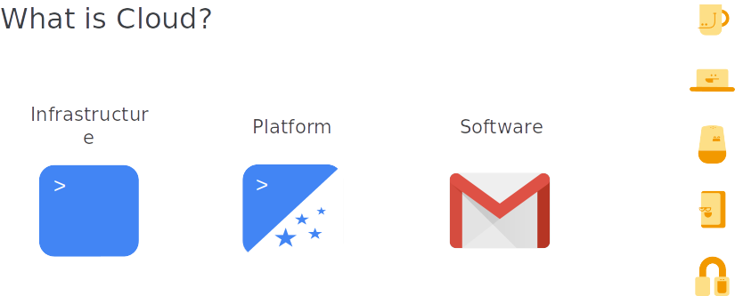

Slide 5
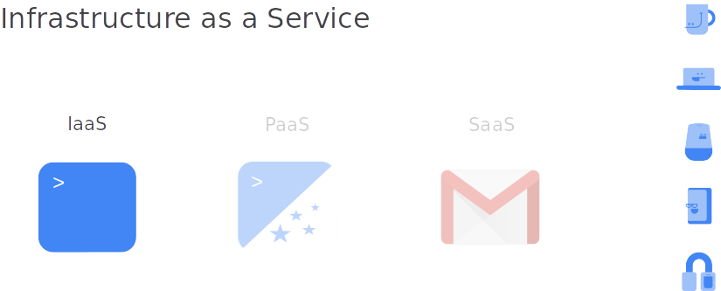

Slide 6
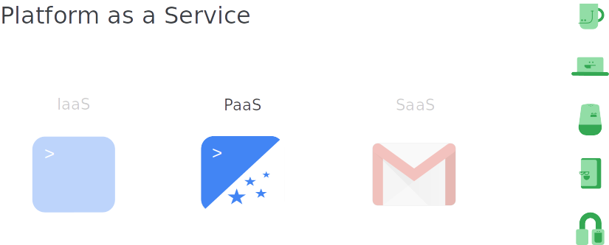

Slide 7
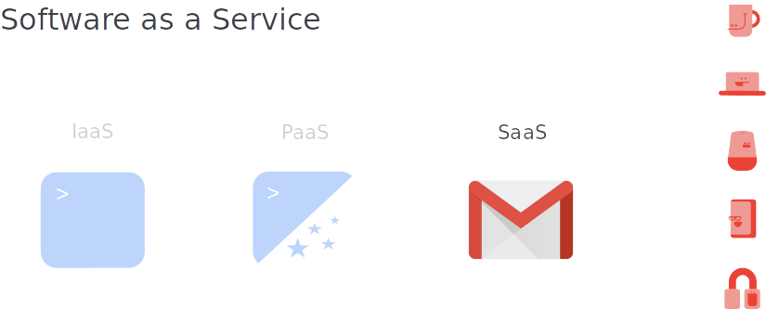

Slide 8
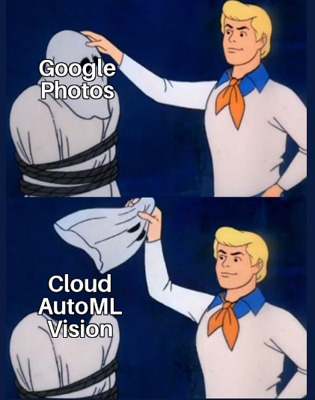
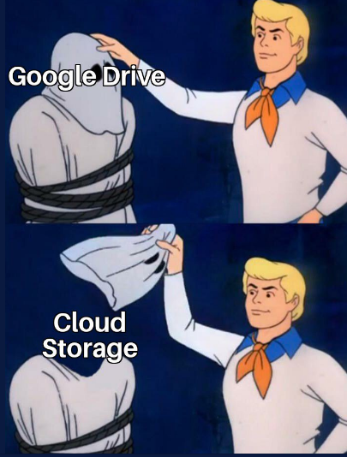
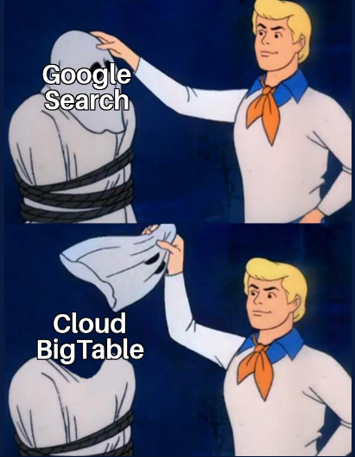

Slide 9
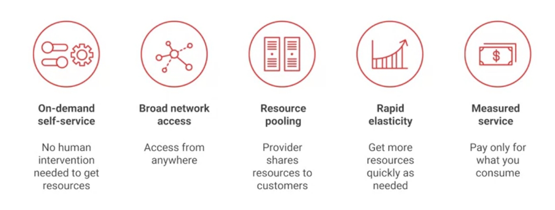
Why Cloud?

Slide 10
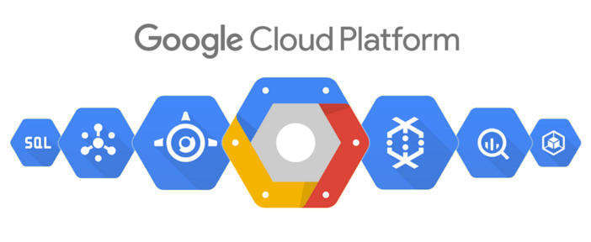

Slide 11
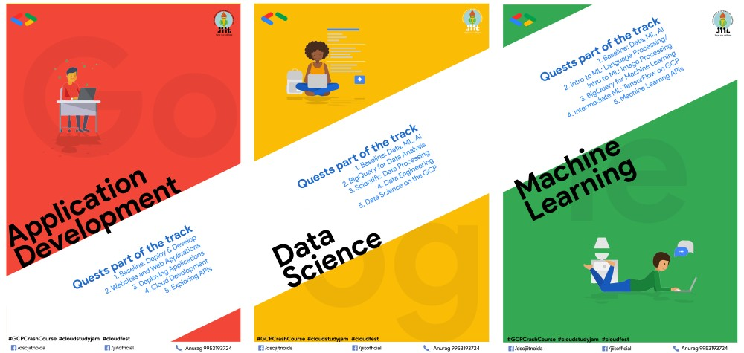

Slide 12
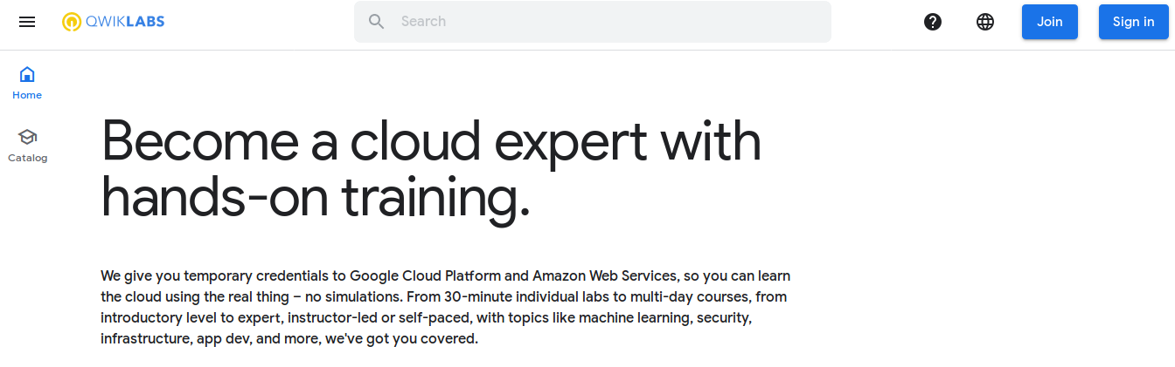

Slide 13
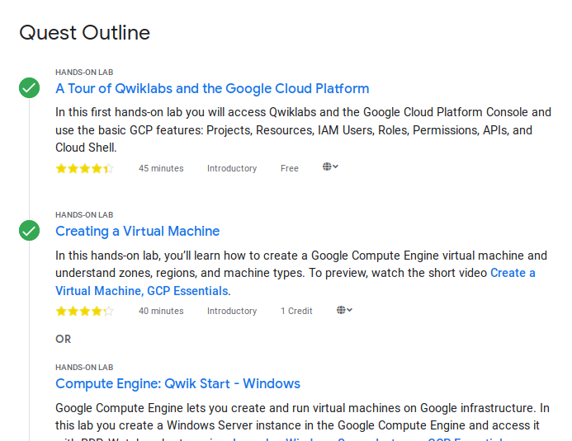

Slide 14
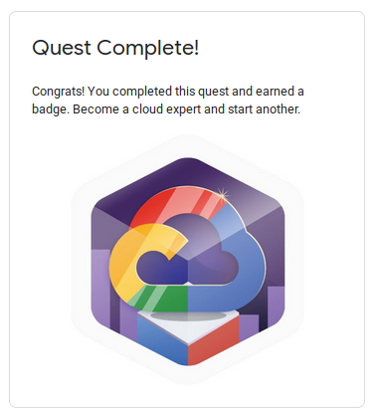

Slide 15

Go Cloud!

Slide 16
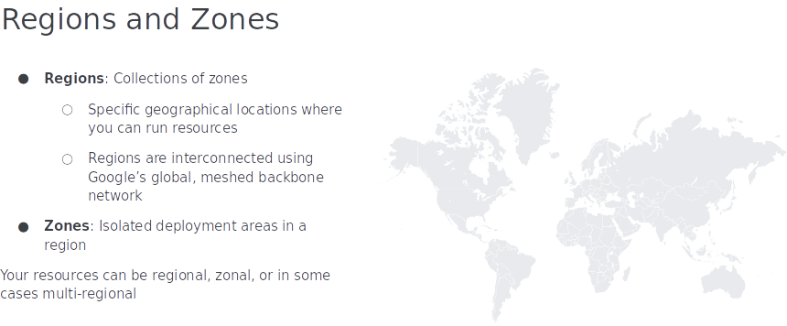

Slide 17
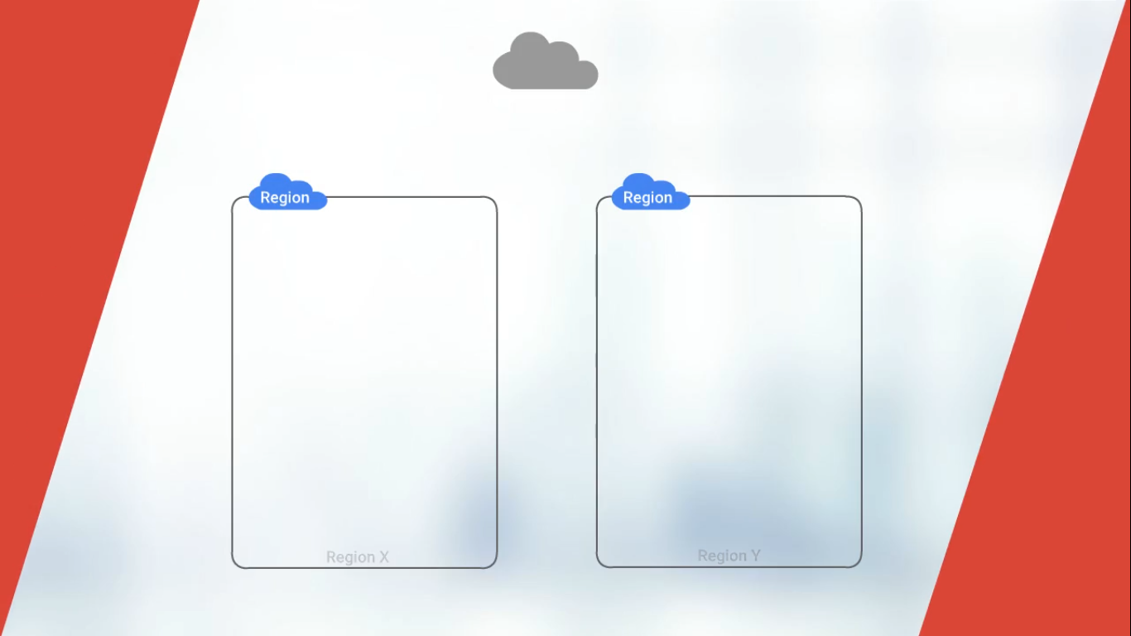

Slide 18
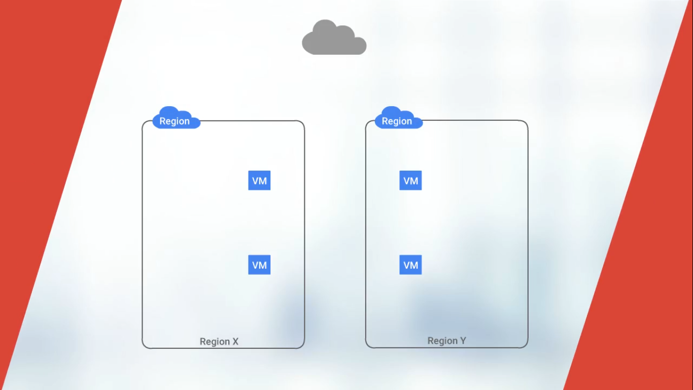

Slide 19
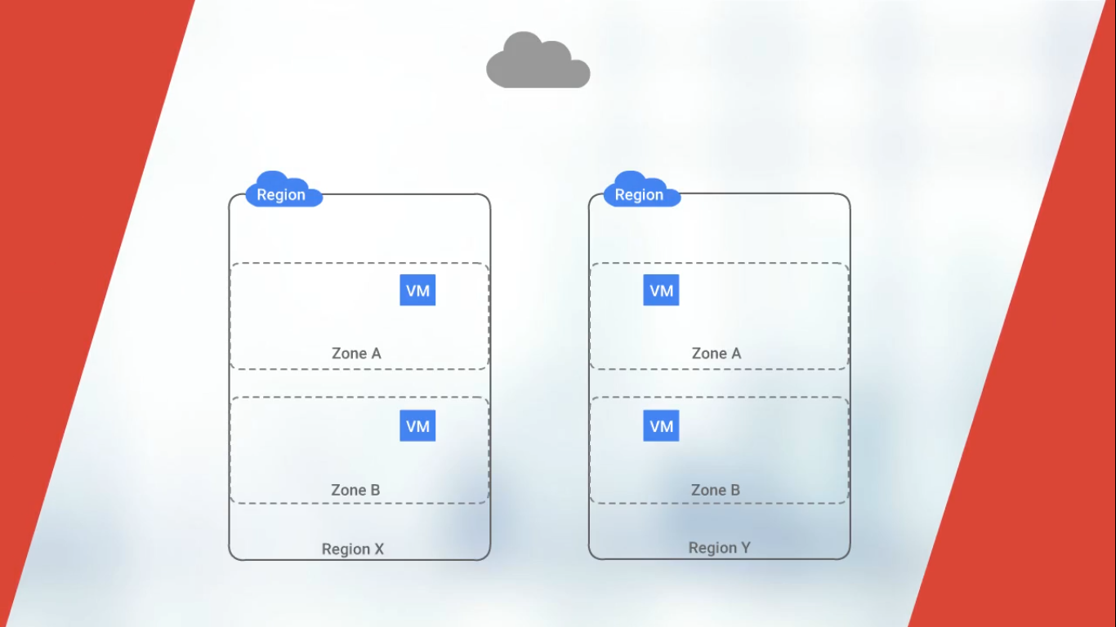

Slide 20
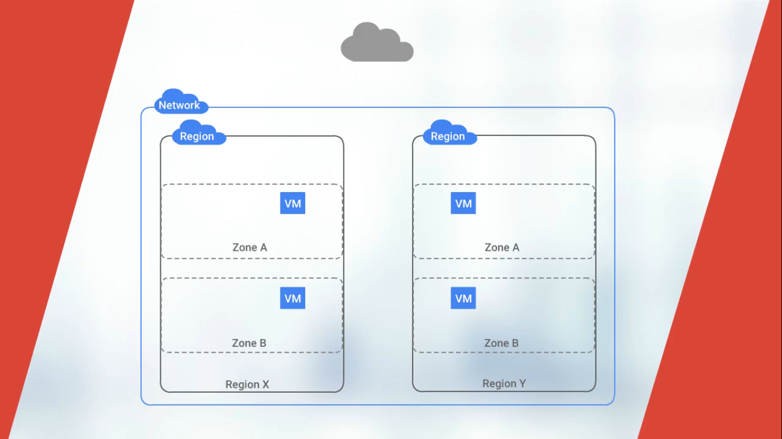

Slide 21
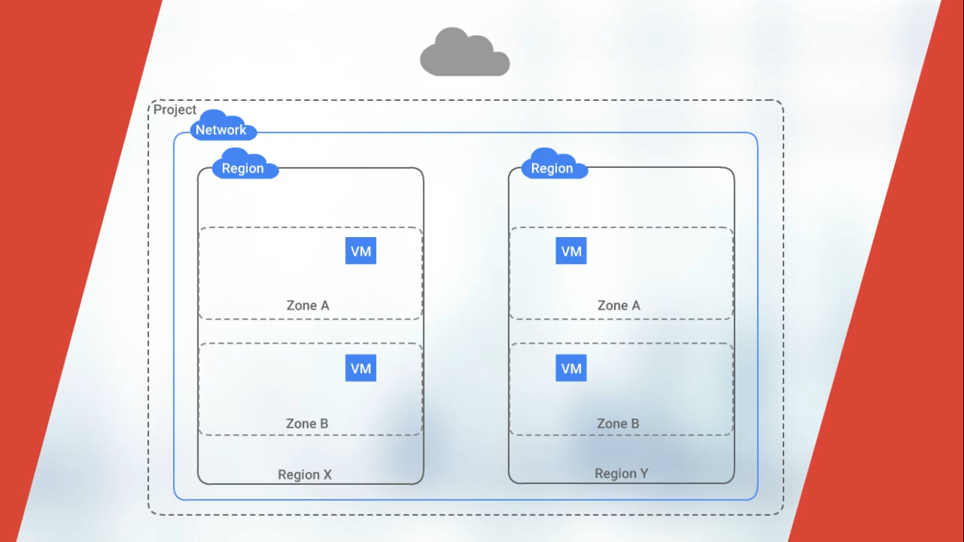

Slide 22
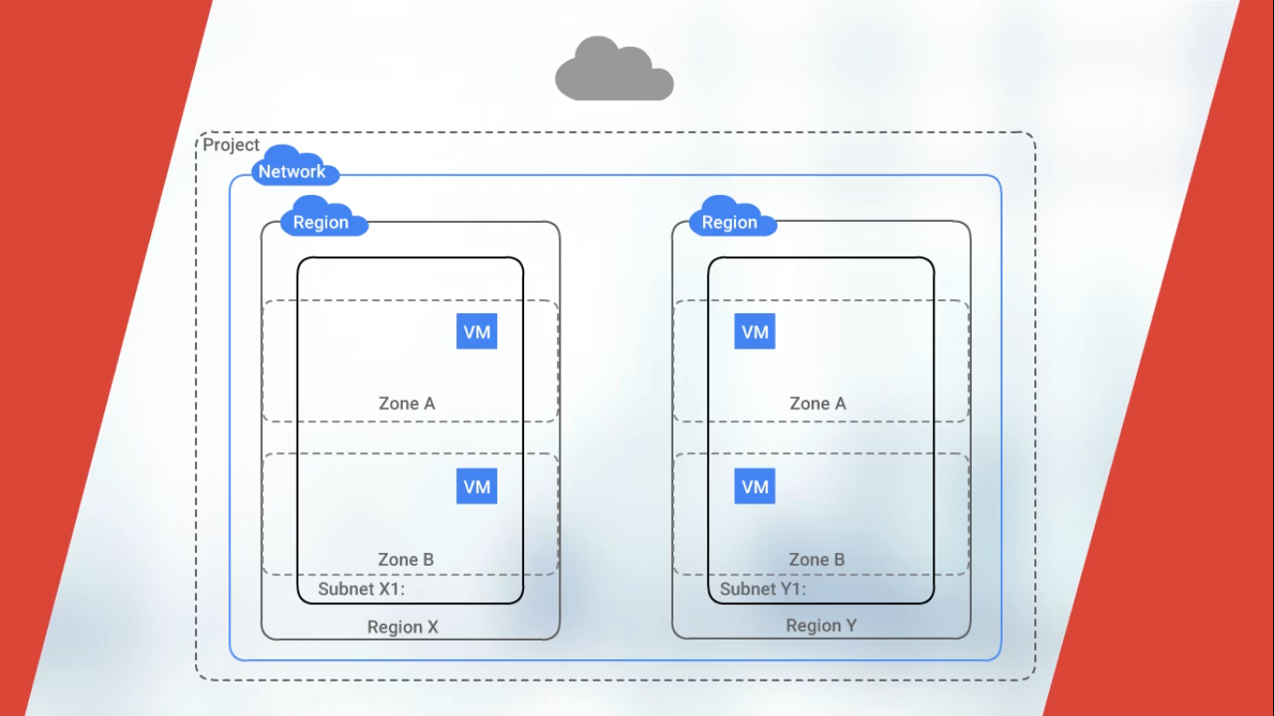

Slide 23


Slide 24
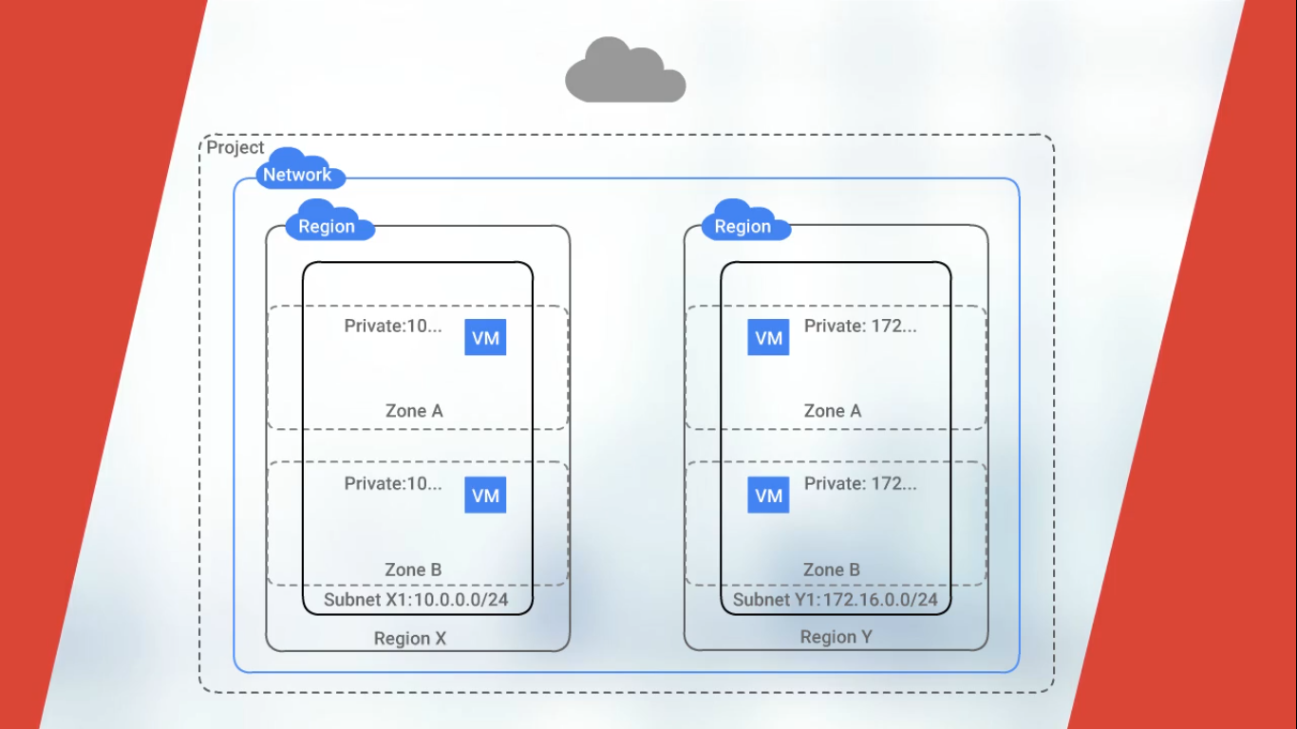

Slide 25
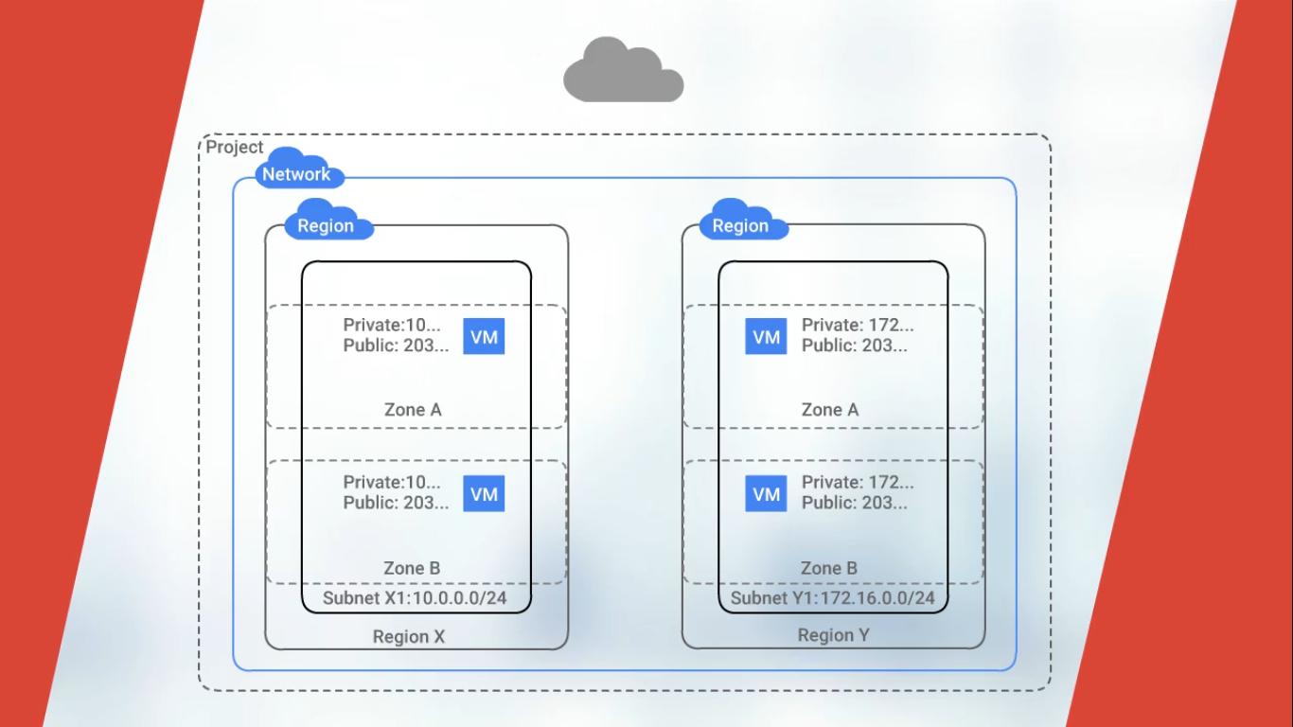

Slide 26
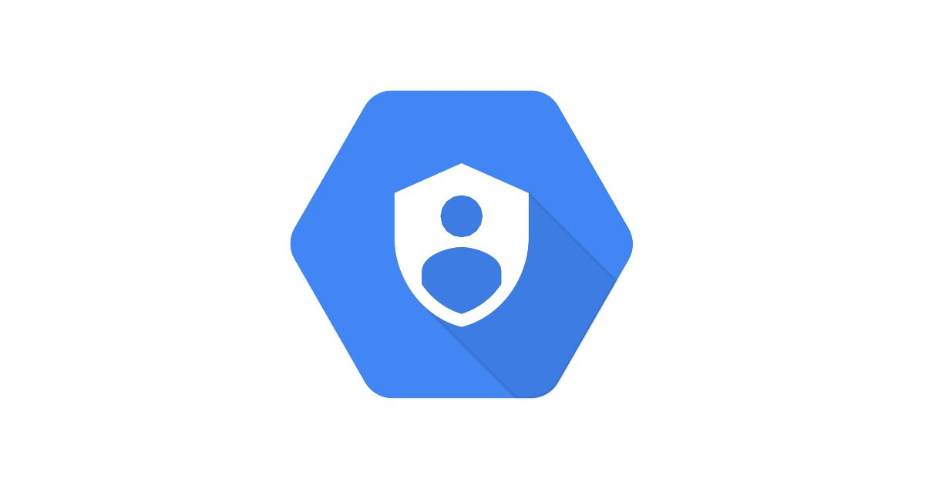

Slide 27
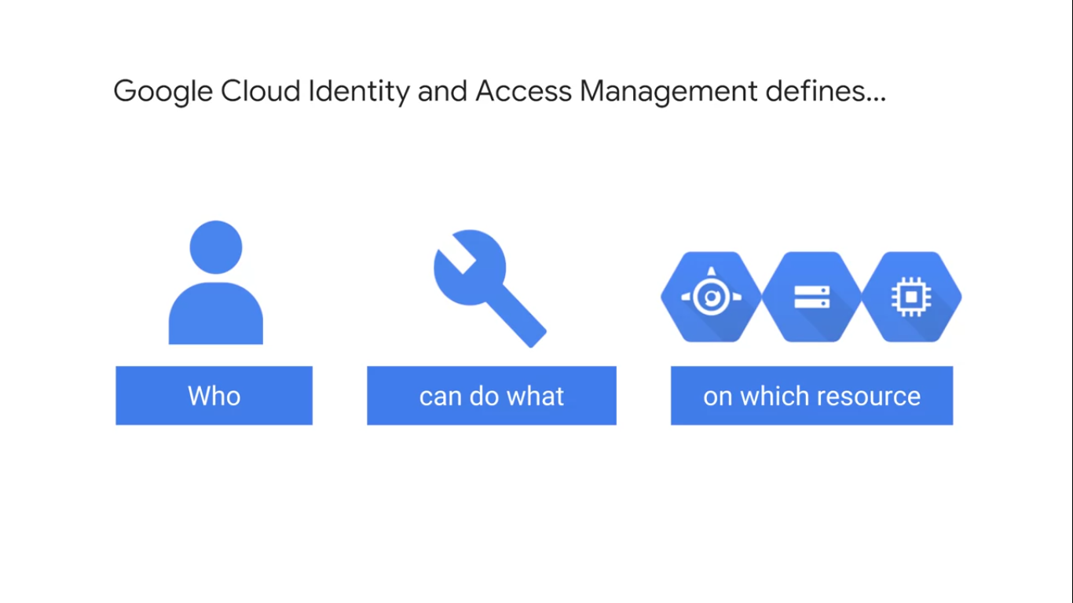

Slide 28
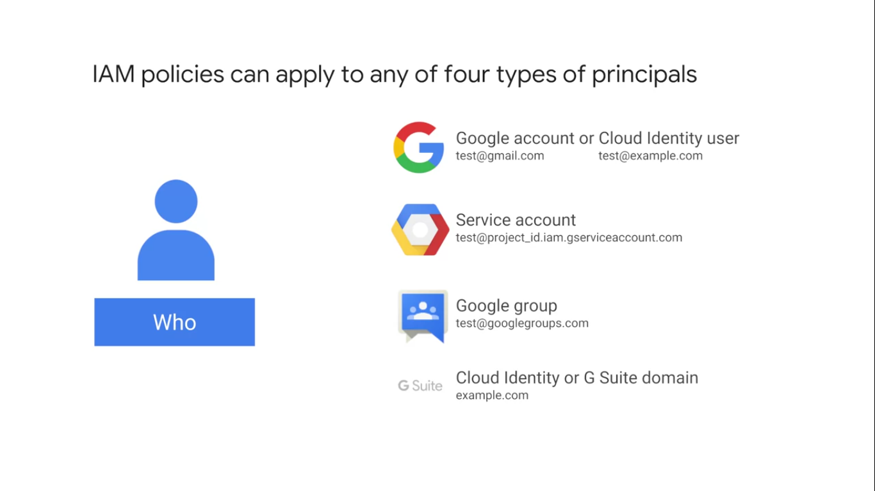

Slide 29
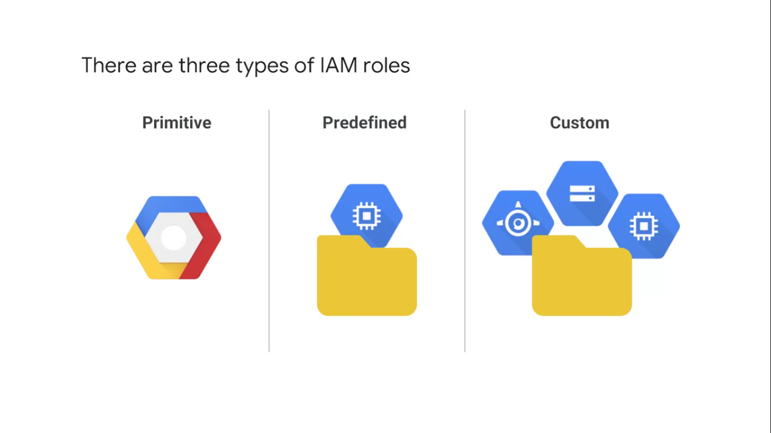

Slide 30
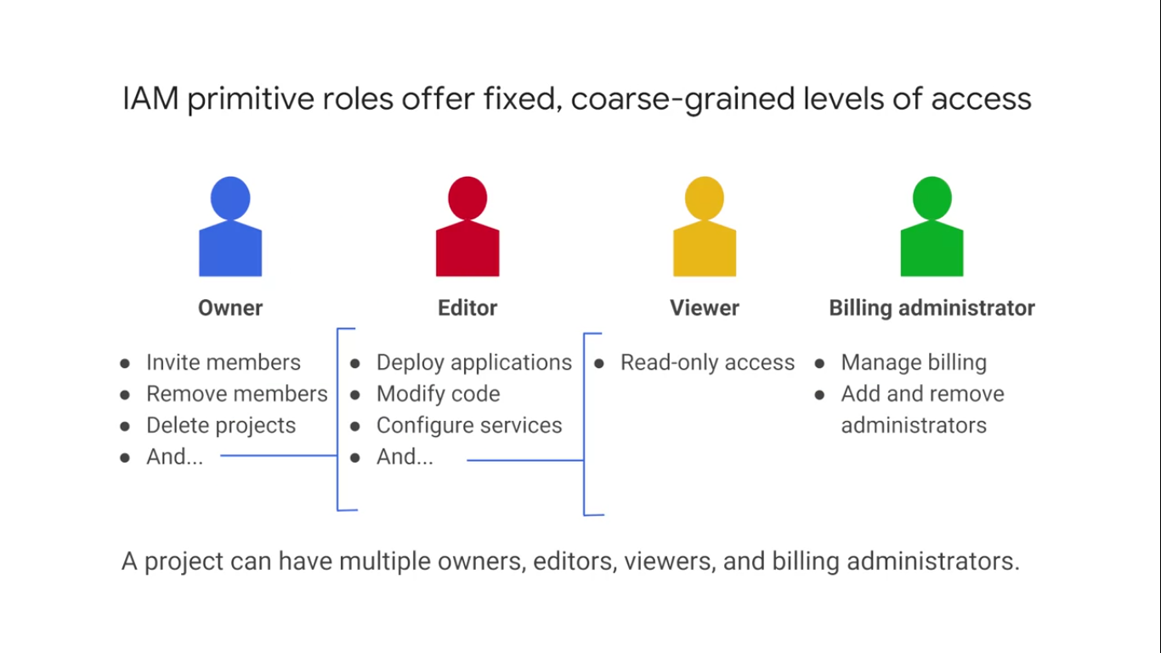

Slide 31
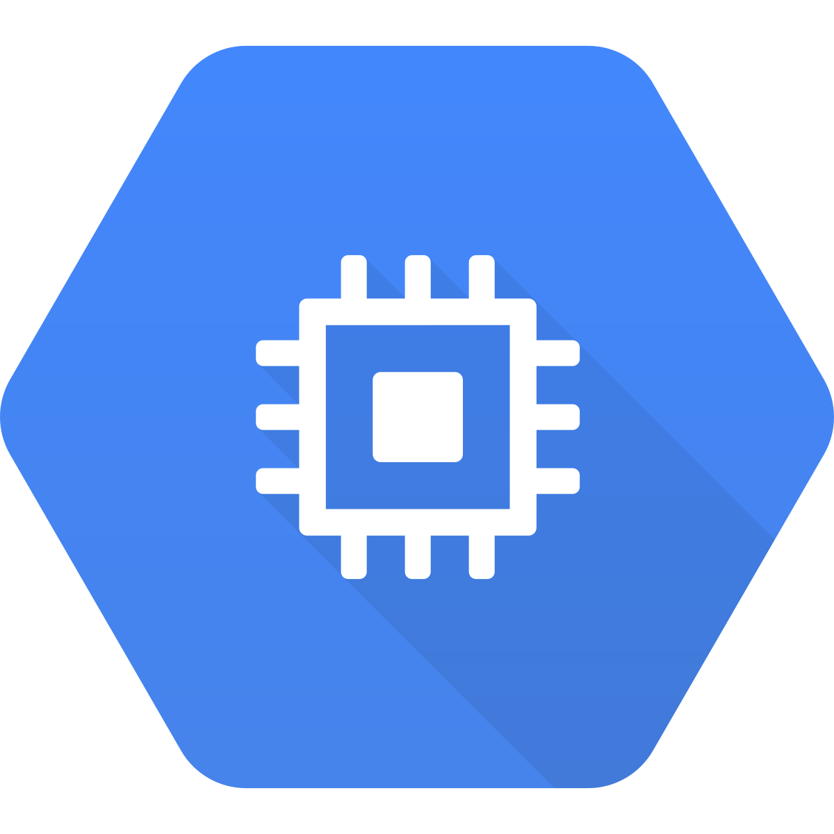

Slide 32
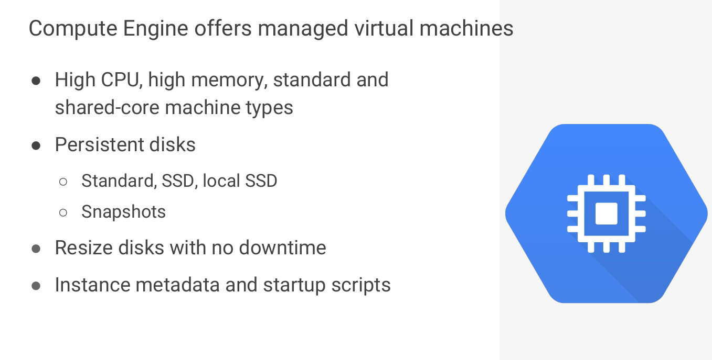

Slide 33
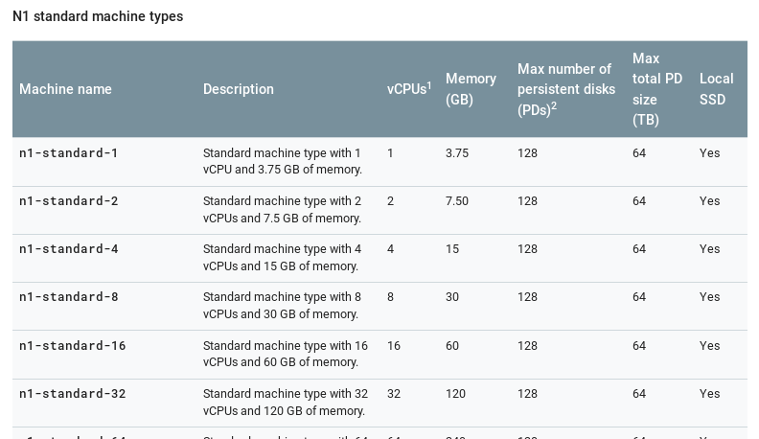
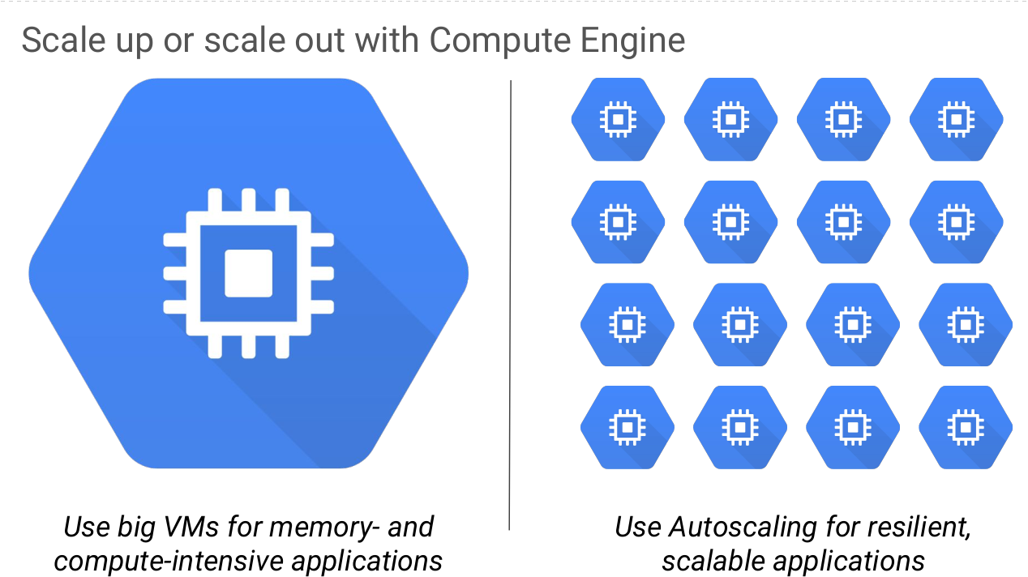

Slide 34
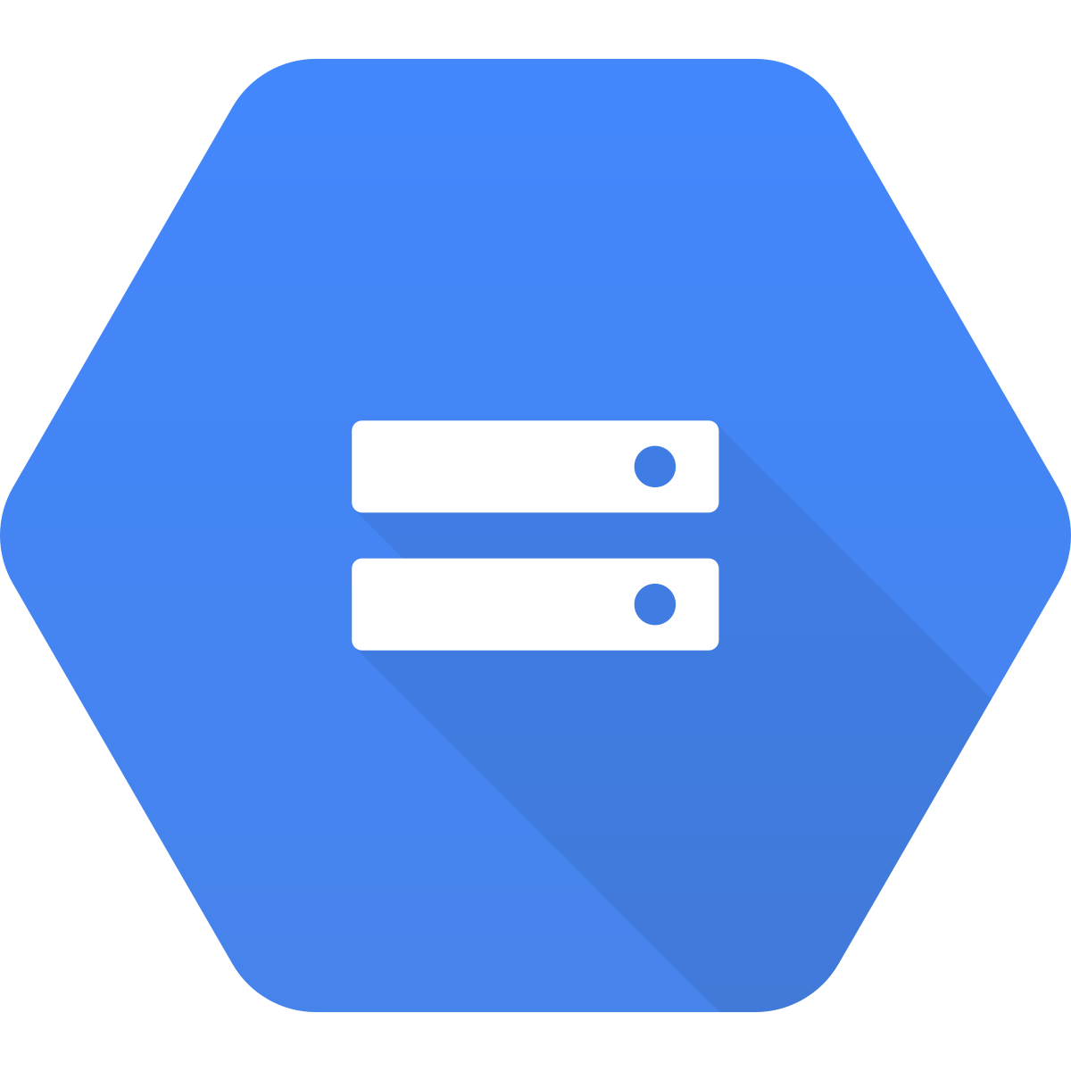

Slide 35
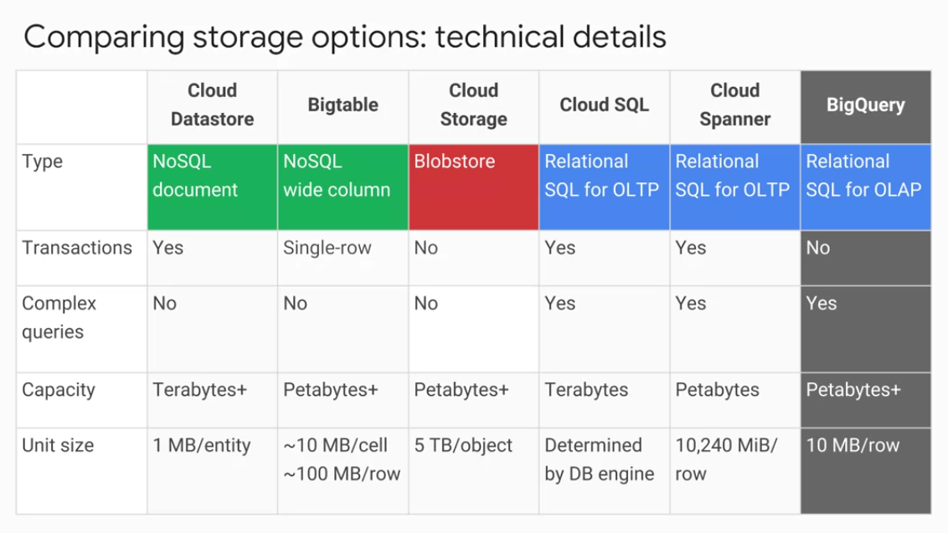

Slide 36
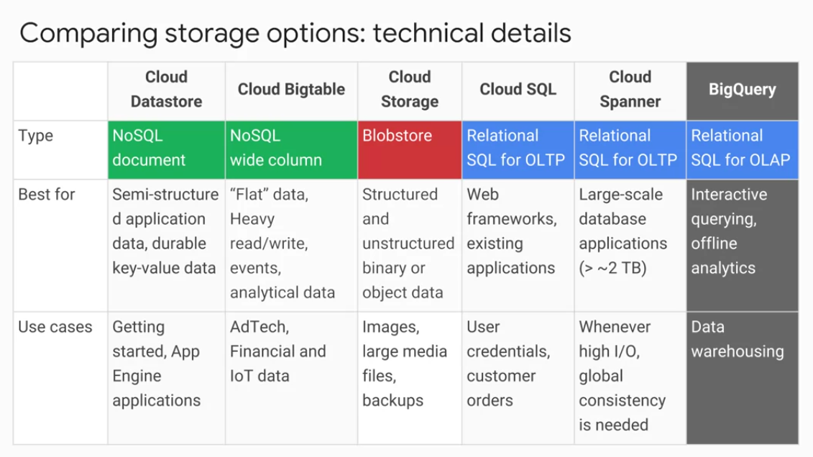

Slide 37

Lab time!
Go to qwiklabs.com
Go to qwiklabs.com
Sign-In / Log-In
In the search bar, look for “GCP Essentials”
Enroll in the quest.
Start the first lab.
“A tour of Qwiklabs and Google Cloud Platform”

Slide 38

Time to get the monthly subscription!
Data and ML Track
https://google.qwiklabs.com/quests/34
Application Development Track
https://google.qwiklabs.com/quests/37

Slide 39
Lab time … v2.0!
Go to qwiklabs.com
Go to qwiklabs.com
Sign-In / Log-In
In the search bar, look for “GCP Essentials”
Start the second lab.
“Creating a Virtual Machine”

Slide 40
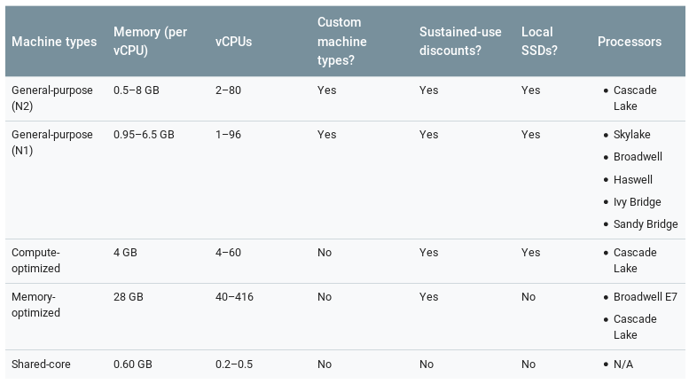

Slide 41
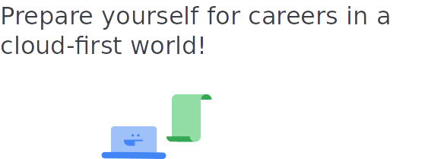
Google Cloud Career Readiness Program

Slide 42
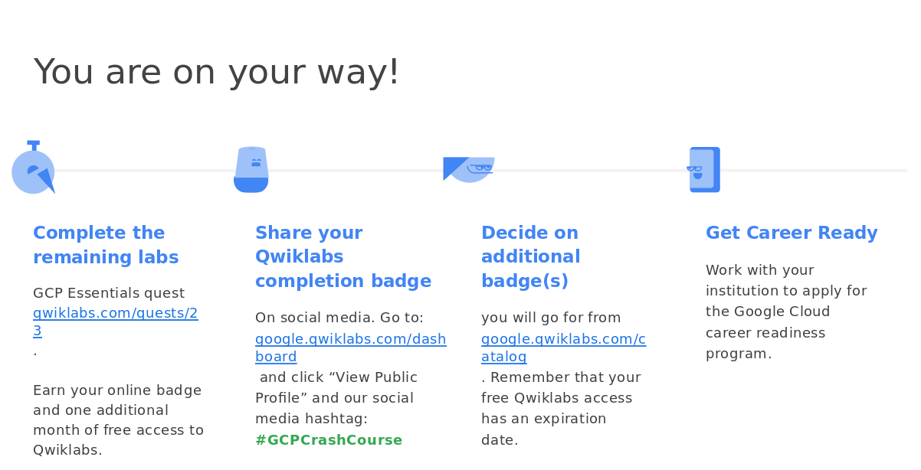

Slide 43
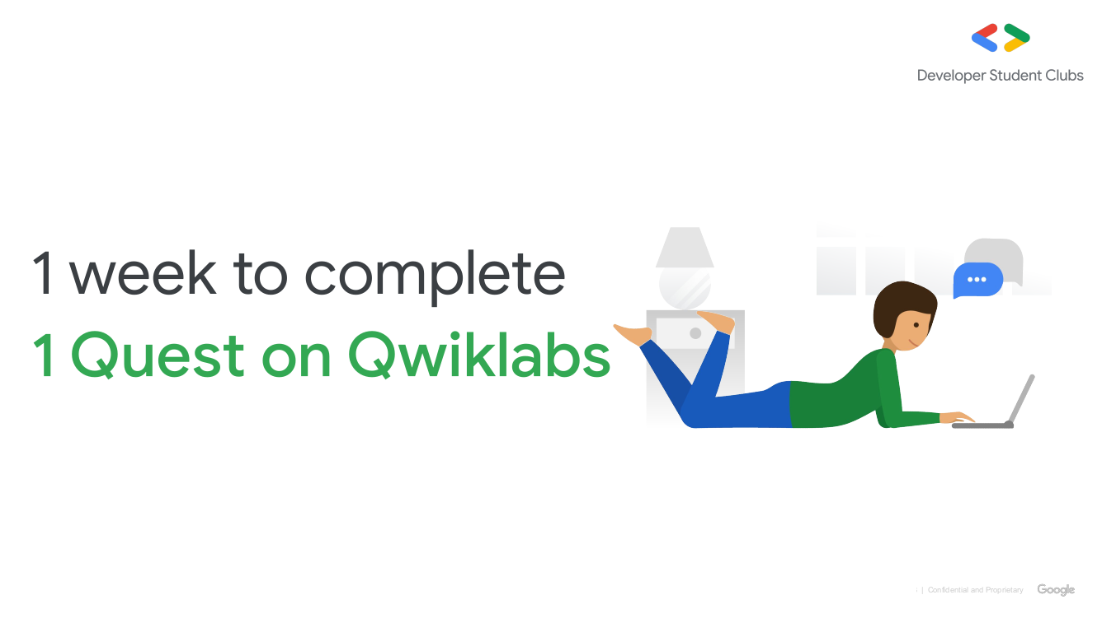

Slide 44
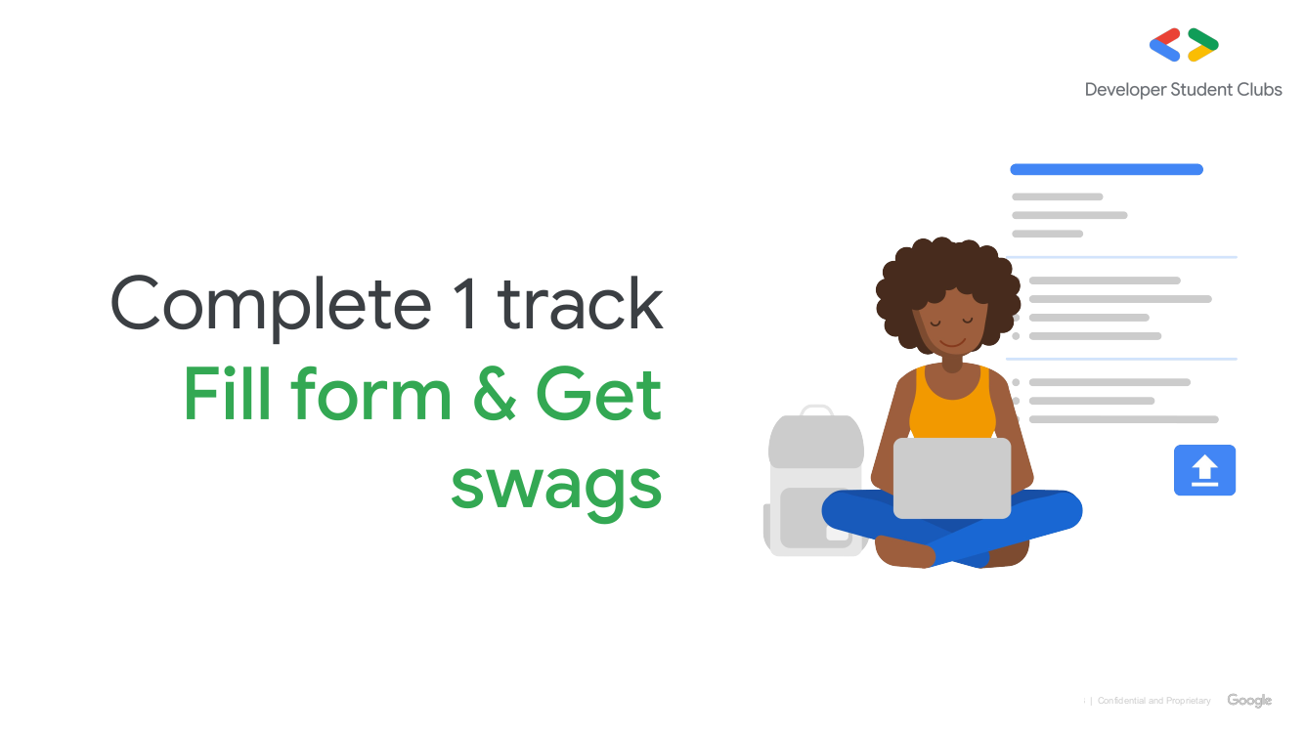

Slide 45


Slide 46
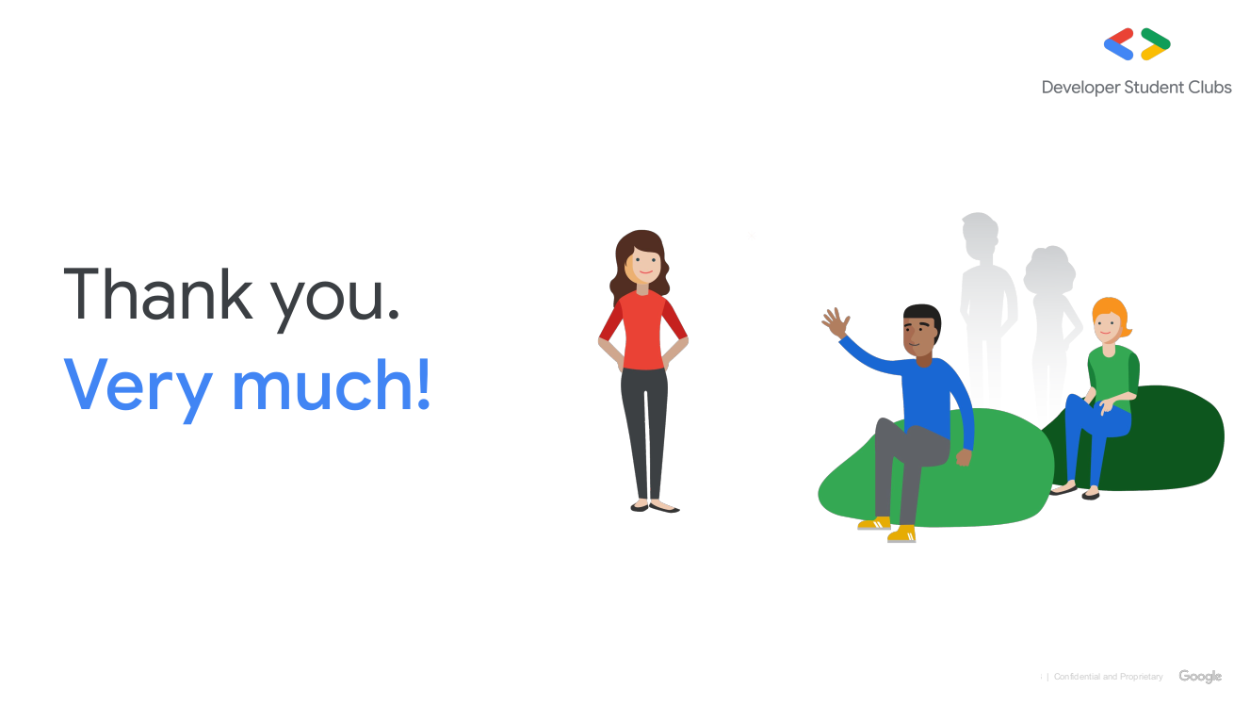

Slide 47
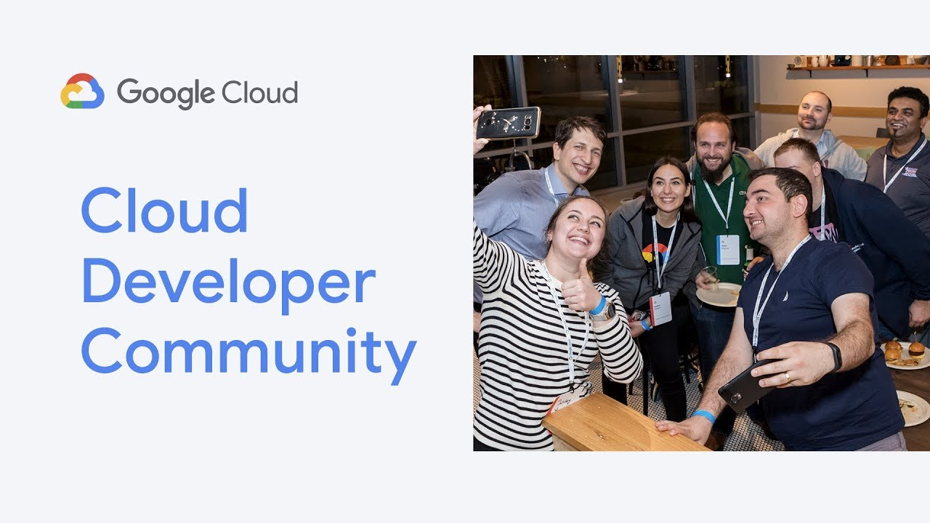

Slide 48



Follow us at ...
https://www.facebook.com/dscjiitnoida/
https://www.linkedin.com/in/vibhu4agarwal/
https://www.linkedin.com/in/anuraged51a/

